Slide 1
Section 3.4 Vieta’s Formulas
© Copyright all rights reserved to Homework depot: www.BCMath.ca

Slide 2
What is Vieta’s Formula?
Suppose you have a polynomial with several roots, like below:
The leading coefficient is “A”, the first step is divide all terms by “A”
Vieta’s formula gives an equation for each coefficient on the left as a function of the roots on the right
Negative Sum of the roots
Product of all the roots

Slide 3
II) Coefficients of a Polynomial (Vieta)
The coefficients of a polynomial can be used to determine the sum and product of the roots
Suppose we have a quadratic function with two roots
Expand and FOIL
The constant “C” is equal to the product of the roots
The coefficient “B” is the negative sum of the roots
Negative product of all the roots
Negative sum of all the roots

Slide 4
Ex: Suppose a polynomial F(x)=x³+Bx²+Cx+D has the following roots: 1, 2, and – 4. What are the values of the coefficients “B” “C” and “D”?

Slide 5

Ex: Given that the polynomial $$y=x6+bx5+cx4+dx3+ex2+fx+g=\left(x−2\right)\left(x−3\right)\left(x−4\right)(x−5)(x−6)(x−7)$$
a) What is the value of $b+c+d+e+f+g?$
b) What is the value of $b+c=?$
c) What is the value of $b+d+f=?$

Slide 6
Ex: Given that the roots of the polynomial below are “a”, “b” and “c”, find the following:
1st: Divide the function by 2
i) Find the value of

Slide 7
What is the Vieta’s formula?
When given a polynomial in the form of:
These formulas will relate the coefficients with the roots

Slide 8
Ex: Find the coefficients “a”, “b”, “c”, “d”, and “e”
Note: a=2

Slide 9
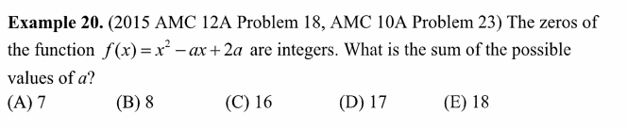
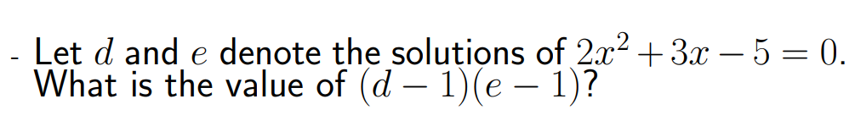
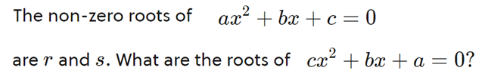

Slide 10



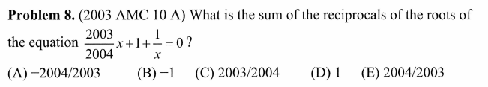

Slide 11
Given that the polynomial has three distinct roots:
The polynomial below also has the three same roots:
What is the value of f(1)?

Slide 15



Slide 17
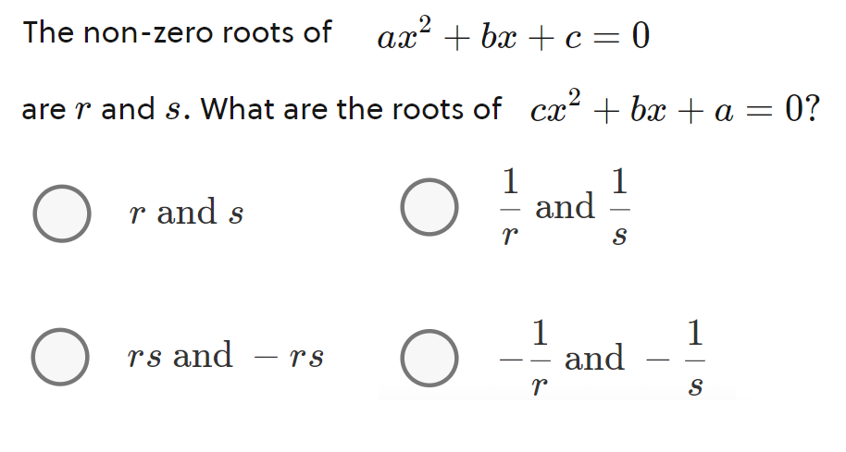

Slide 19
Given that the polynomial has three distinct roots:
The polynomial below also has the three same roots:
What is the value of f(1)?
Now we can find “b” and “c”
From the first equation:
From the second equation:

Slide 20
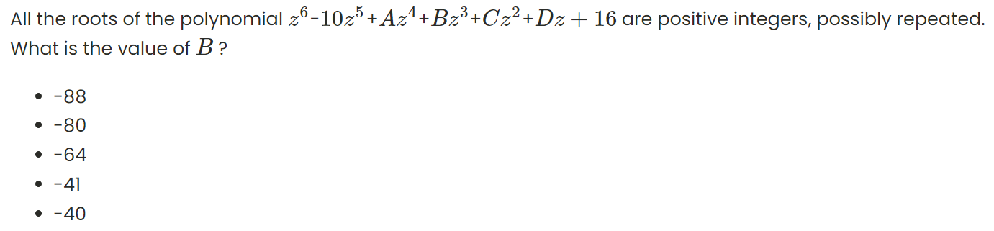
Let the 6 roots be: r1, r2, r3, r4, r5, and r6
With the roots, we can find “B”
The sum of integer roots are -10: so we have:
The product of the 6 integer roots is 16. this means that the 6 integers need to multiply to 16
How many ways can we have 6 numbers multiply to 16
Come up with all the combinations you can think of.
Pick the set where the integers add up to 10

Slide 21
Rewrite the original equation:
Use the binomial expansion to get the first 3 or 4 terms of the binomial on the right
Use this to do the rest…..

Slide 22


